Slide 1

RenderVerse
The art of Motion
Team members :
P Abhignya - 221701002
Abinauv R - 221701003

Slide 2
Abstract
This app is designed to teach animation step by step, from basic sketching to advanced techniques. It includes easy-to-follow tutorials, simple transcripts, and small assignments to keep users engaged. Interactive features, progress tracking, and a community space make learning more effective and enjoyable for aspiring animators.

Slide 3
Introduction
Animation is a dynamic and creative field that requires a blend of artistic skills and technical knowledge. Traditional learning methods often involve complex tutorials and extensive practice, which can be daunting for beginners. This animation teaching app aims to simplify the learning process by breaking down complex concepts into manageable modules. The app is designed to be user-friendly, interactive, and accessible, catering to a wide range of learners from novices to advanced users.

Slide 4
Objectives
Primary Objective
To create an interactive and accessible learning platform that simplifies animation concepts, keeps users engaged, and fosters a supportive community for continuous skill development.
Goals
Break down complex concepts into simple, easy-to-follow modules for effective learning.
Incorporate interactive elements like quizzes and assignments to boost engagement.
Ensure accessibility by supporting users of all skill levels and abilities.
Create collaborative community where users can share work, ask questions, and get feedback.
Continuously improve content through user feedback and regular updates.

Slide 5
Literature Survey
Feature / App | Native language support | Gamification Elements | Hands on practice | Project based learning | Learning approach
RenderVerse | Teaches in multiple native languages | Badges, progress tracking, and challenges | Interactive exercises and projects | Step-by-step guided projects | Step by step interactive learning
Udemy / coursera | Mostly English with limited subtitles | Limited or none | Mostly theory based | Depends on the instructor | Pre-recorded video lectures.
Khan Academy | Primarily English | None | Limited to exercises | Not structured for projects | Video based learning.
Blender Cloud | Mainly English | None | Blender projects | Blender projects | Tutorial based learning.
Skill share | Limited translations | Some badges | Community projects | Yes | Project based learning.

Slide 6
Literature Survey
Animation education has evolved significantly with digital tools and online platforms, enhancing engagement and comprehension through interactive, modular learning. Unlike traditional learning apps that rely on passive video lectures, RenderVerse offers an immersive, hands-on approach to teaching animation, covering modeling, rigging, lighting, and more. A key differentiator is its native language support, making complex animation concepts accessible to learners worldwide. Additionally, gamification elements such as badges and progress tracking keep users motivated, while step-by-step guided projects ensure practical learning. Unlike platforms like Udemy or Blender Cloud, RenderVerse emphasizes community-driven learning, enabling users to collaborate, share projects, and grow together. This structured yet interactive approach makes RenderVerse an innovative and beginner-friendly solution for mastering animation.

Slide 7
Methodology
The platform will teach sketching to advanced animation through step-by-step modules. Interactive quizzes, drag-and-drop exercises, and clickable hotspots will keep users engaged, while progress tracking helps them stay motivated. A community section allows users to share work, ask questions, and get feedback. Gamification elements like badges and leaderboards make learning fun. Accessibility features such as subtitles and screen reader support ensure inclusivity. Regular updates keep content fresh, and a feedback system lets users rate tutorials and suggest improvements. The mobile-friendly design supports learning on the go, and project-based tasks help users apply their skills.

Slide 8
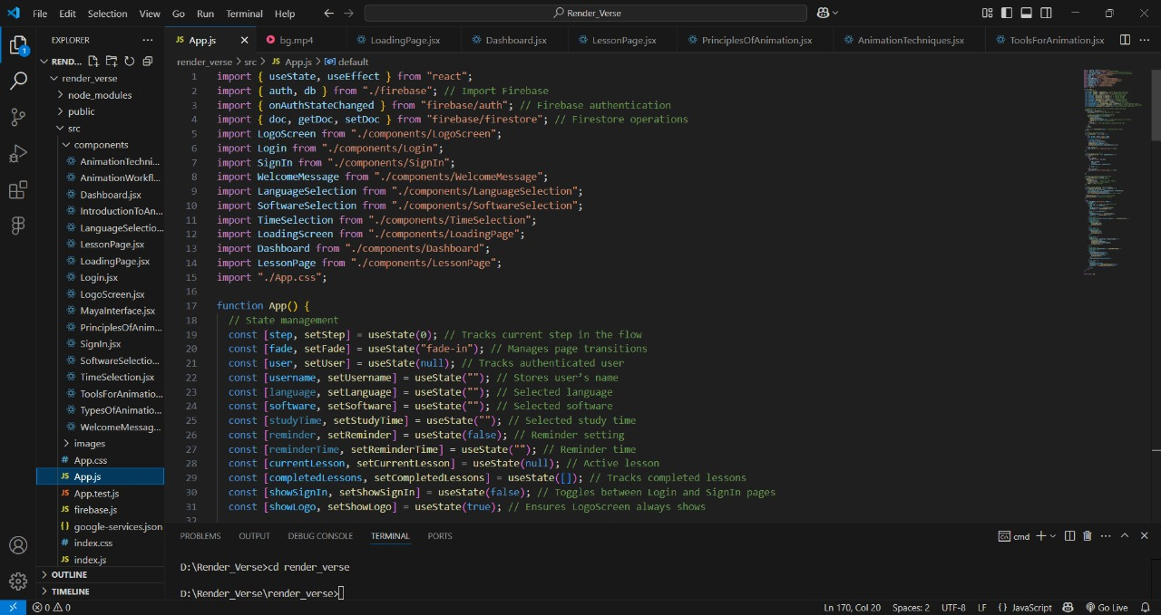
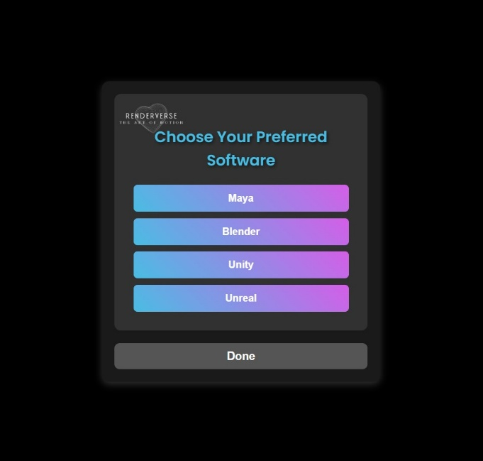
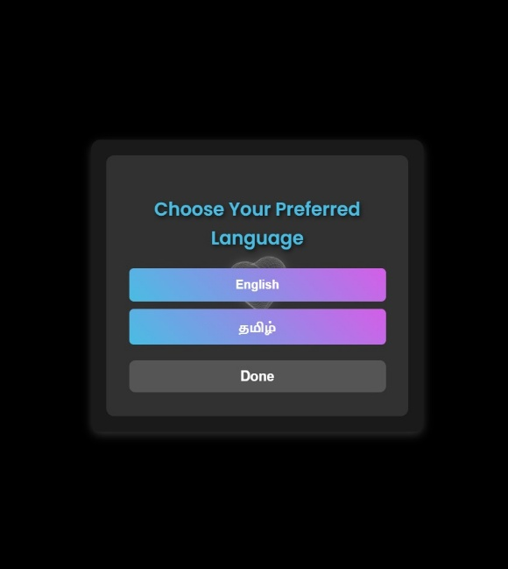
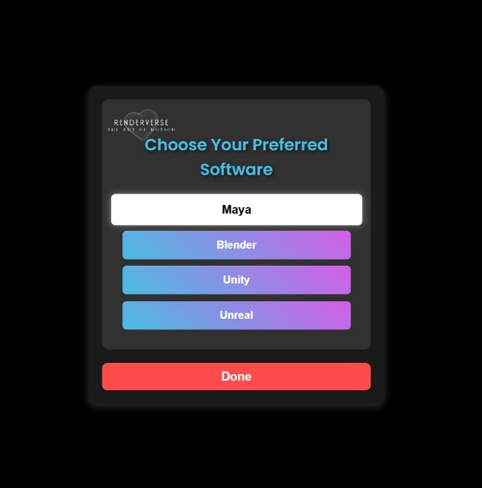
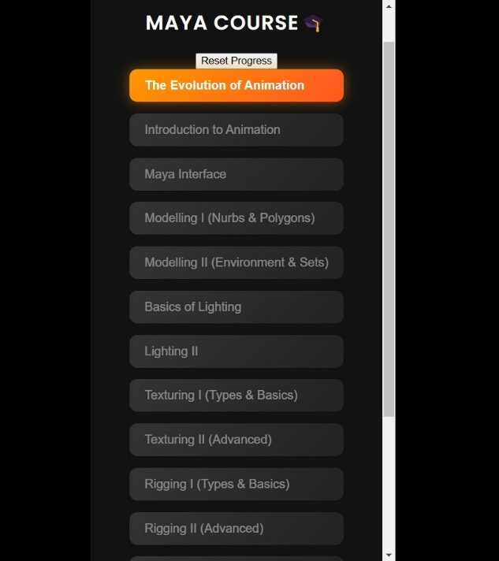
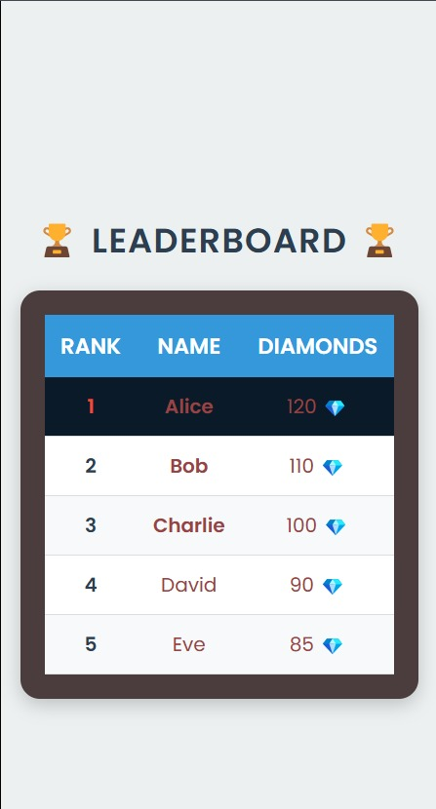
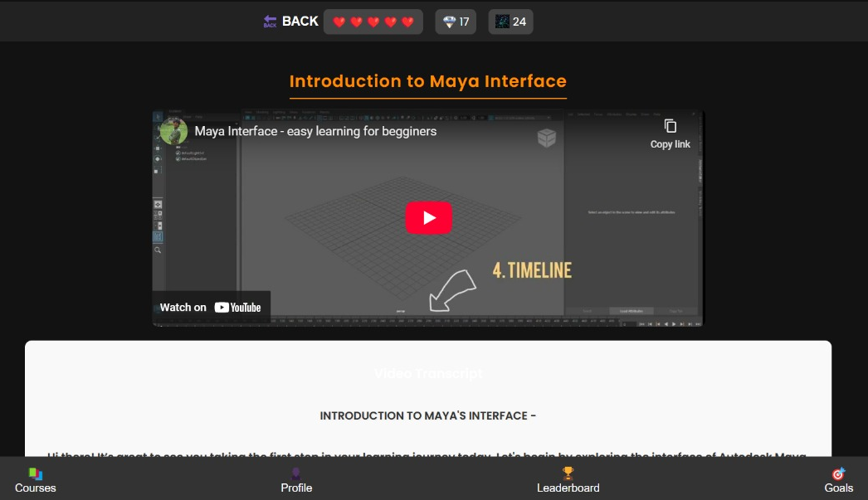
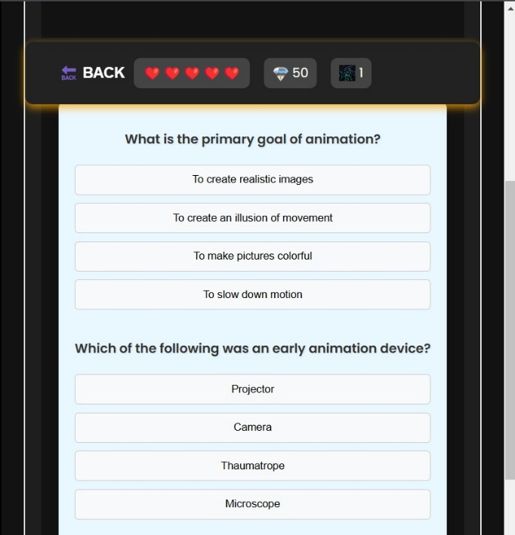
Output

Slide 9
Thank you.

